Slide 1
Introduction to Linear Mixed Effects Models
Reuben Thomas
Michela Traglia
Gladstone Bioinformatics Core
April 24th, 2023

Slide 2
Expected background for this session
Basic understanding of statistics (mean, standard errors, variance, co-variance, experimental design, linear models)
Be used to interpreting plots of data (box plots, scatter plots, line plots)
Basic understanding of R: Manipulation of data frames in dplyr and implementation of simple linear models

Slide 3
Outline for this session
Repeated measures experimental designs are ubiquitous in our field
Several examples from our work: WHERE?
Specialized analyses of data from repeated measures are required to
Capture interesting biology: WHY?
To not be overwhelmed with false positives
Linear mixed effects models provide a very flexible approach to work with these data
Introduction and assumptions for these models: WHAT?
These models can be implemented in the lme4 package in R
Illustrate implementations of these models using different datasets derived from varying experimental designs: HOW?
Concluding remarks

Slide 4
Levels of understanding of statistical models
Plain language
Visual plots/geometry: “Picture worth a thousand words!”
Mathematical rigor
Programmatic implementation

Slide 5
Outline for this session
Repeated measures experimental designs are ubiquitous in our field
Several examples from our work: WHERE?
Specialized analyses of data from repeated measures are required to
Capture interesting biology
To not be overwhelmed with false positives
Linear mixed effects models provide a very flexible approach to work with these data
Introduction and assumptions for these models
These models can be implemented in the lme4 package in R
Illustrate implementations of these models using different datasets derived from varying experimental designs
Concluding remarks

Slide 6
Repeated measures experimental design
Designs where multiple responses from the same biological unit are assessed
Examples include measuring changes in biomarker levels (e.g. CD4 counts) in subjects over time

Slide 7
Cellular assays
Experiment1
Experiment2
Plate 1
Plate 2
Plate 3
Plate 4
CL1
CL 2
CL3
CL1
CL 2
CL3
CL: Cell Line
CL 4
CL 5
CL6
CL 4
CL 5
CL6
Repeated measure: Multiple measurements within same plate and same experimental batch!
Min-Gyoung Shin

Slide 8
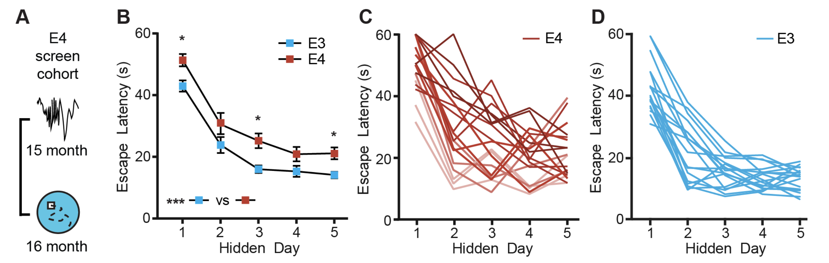
Learning in Alzheimer’s Disease mice assayed in the Morris-Water Maze
Repeated measure: Same mouse assayed for latency on multiple hidden days!
Jones et al. 2019

Slide 9
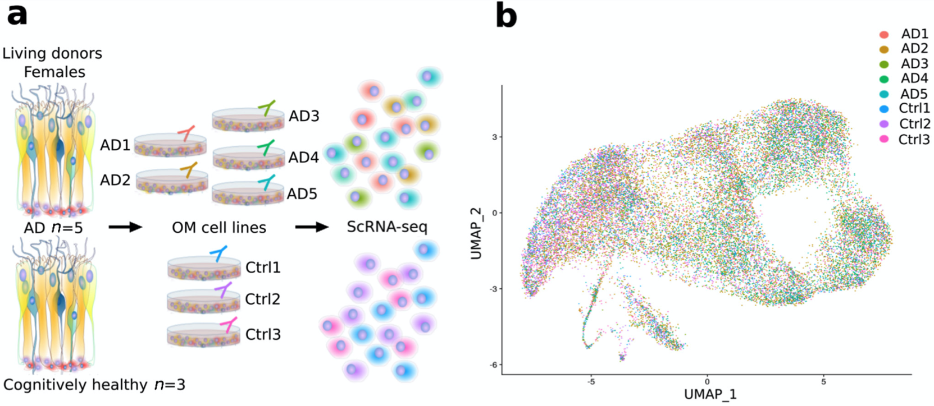
Single-cell RNA-seq: Olfactory mucosa differences between 5 AD patients and 3 cognitively healthy subjects
Repeated measure: Cells from the same human subject assayed for gene expression!
Lampinen at al. 2022
Notes:
https://www.ncbi.nlm.nih.gov/pmc/articles/PMC8870160/pdf/cells-11-00676.pdf

Slide 10
Outline for this session
Repeated measures experimental designs are ubiquitous in our field
Several examples from our work
Specialized analyses of data from repeated measures are required to
Capture interesting biology: WHY?
To not be overwhelmed with false positives
Linear mixed effects models provide a very flexible approach to work with these data
Introduction and assumptions for these models
These models can be implemented in the lme4 package in R
Illustrate implementations of these models using different datasets derived from varying experimental designs
Concluding remarks

Slide 11
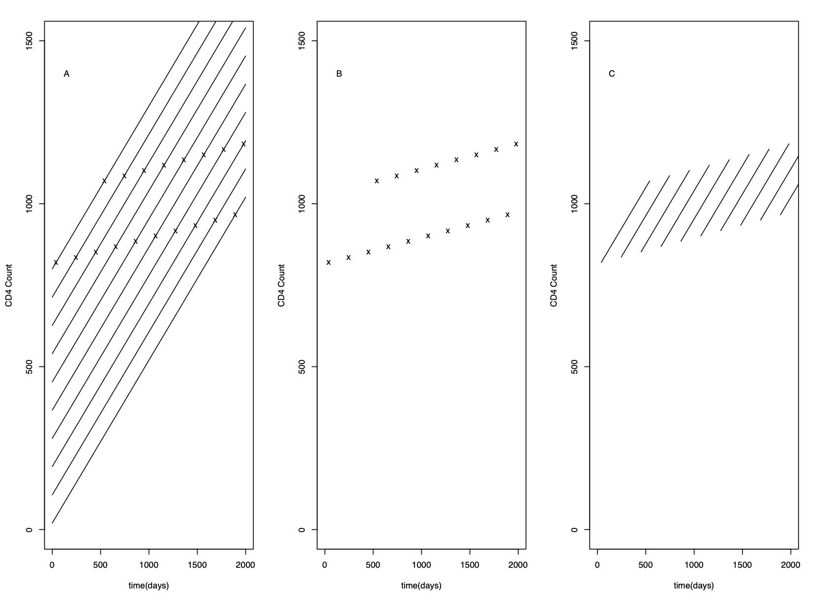
Estimate changes in CD4 count over time in patients undergoing ART
Subject 1
Longitudinal effect
Subject 10
CD4 cell count
Cross-sectional effect
Later you sample
the patients the
higher their starting
CD4 counts are
Cross-sectional effect ≠ Longitudinal effect
Biased estimates!`
Time since initiation of ART
Adapted from Alan Hubbard and Nicolas Jewell, UCB

Slide 12
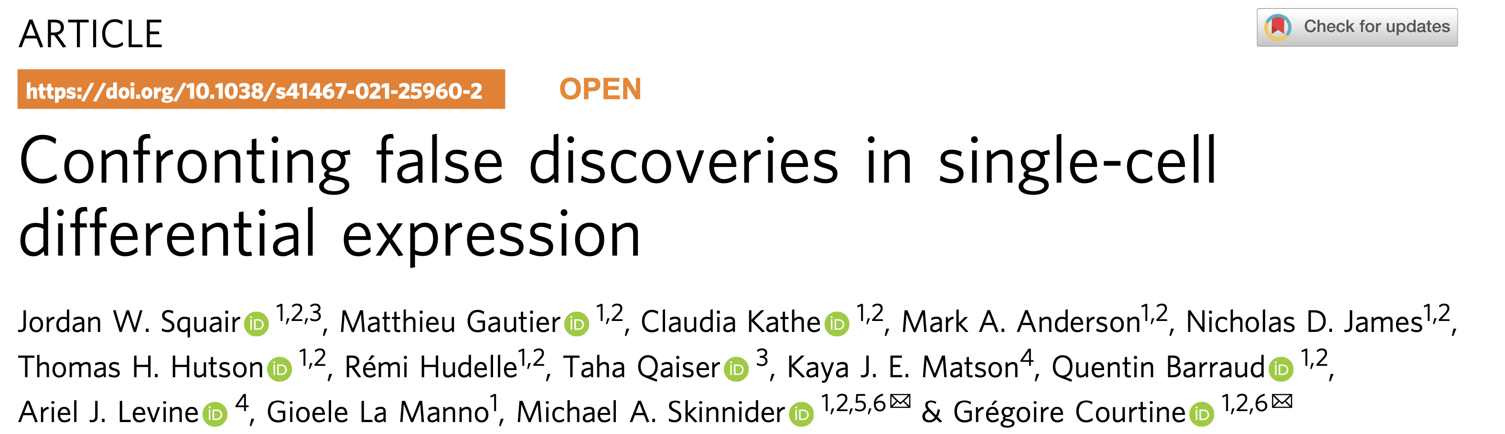
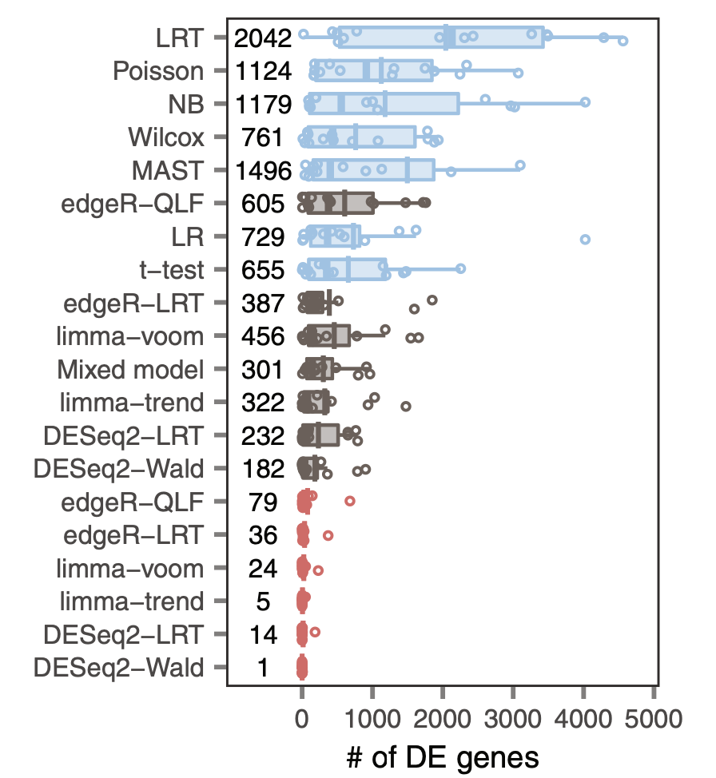
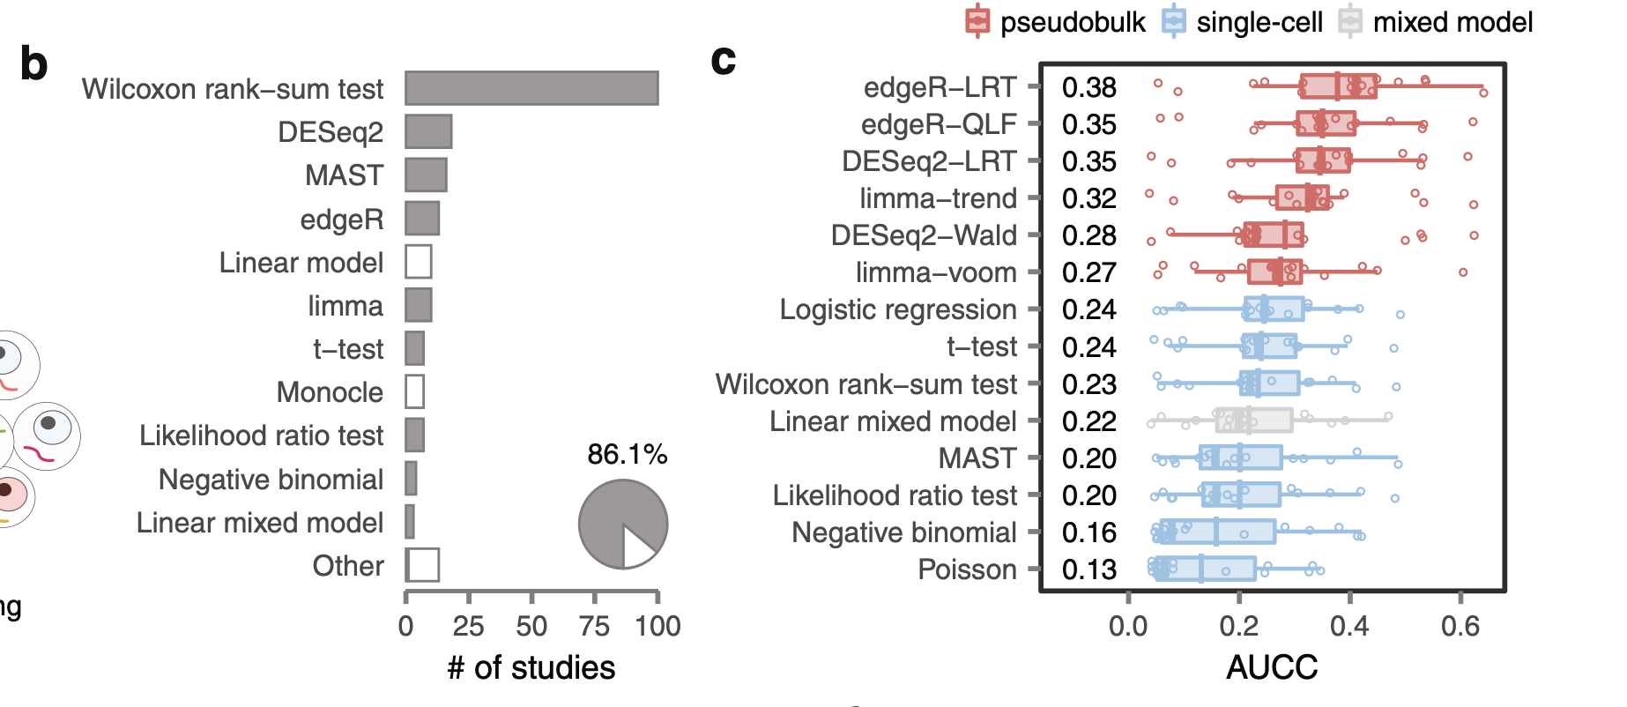
Assessment of True Positives
Assessment of False Positives

Slide 13
Let us do some math to explain the increased false-positive observations

Slide 14
1. Aggregation: one number (mean) to capture an entire distribution

Slide 15
Sampling distribution captures the distribution of the chosen statistic over repeated experiments
Standard error captures the spread of this distribution
Area under the curve provides the fraction of time one observes given ranges of the difference
in means

Slide 16
How does the sampling distribution change with different estimates of standard error?
Larger standard error
Smaller standard error
What happens of one incorrectly estimates the standard errors?
Elevated or lower than expected false positives!

Slide 17
Example problem and model of the data
Objective: Estimate the mean of the average CD4 count at the two time points of the m subjects in the study

Slide 18
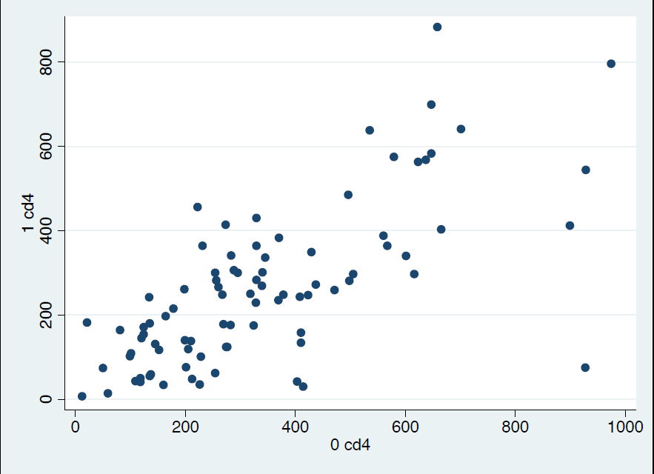
Subjects with higher CD4 counts at first time-point tend to have higher CD4 counts at the second time-point
Adapted from Alan Hubbard and Nicolas Jewell, UCB

Slide 19
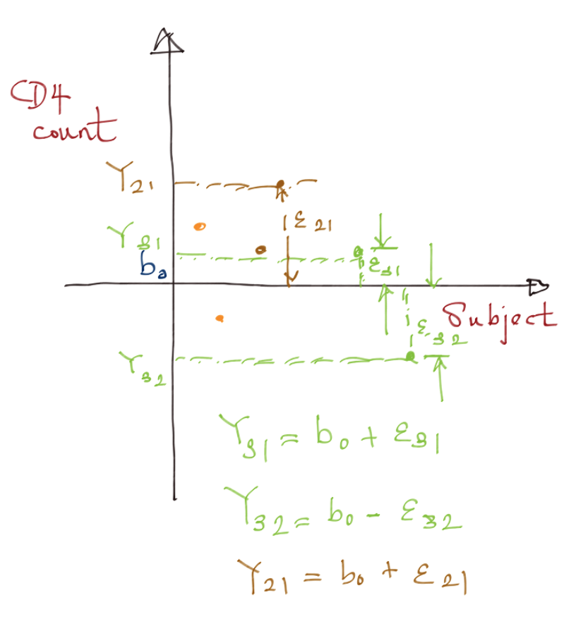
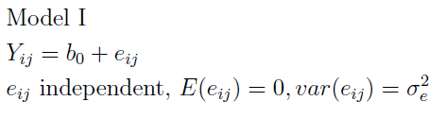

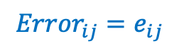
$$Y_{ij}=b_{0}+{Error}_{ij}$$
$${Error}_{ij}=e_{ij}$$
Y_{ij} is the CD4 count for subject i at time-point j
b₀ is the mean CD4 count that we are trying to estimate
How would a picture of the model look like?
Will we be able to see a correlation of CD4 between the two timepoints?
NO!
Adapted from Alan Hubbard and Nicolas Jewell, UCB

Slide 20
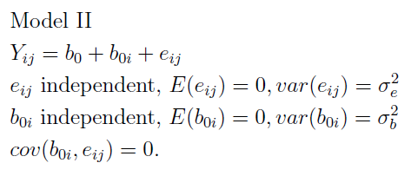
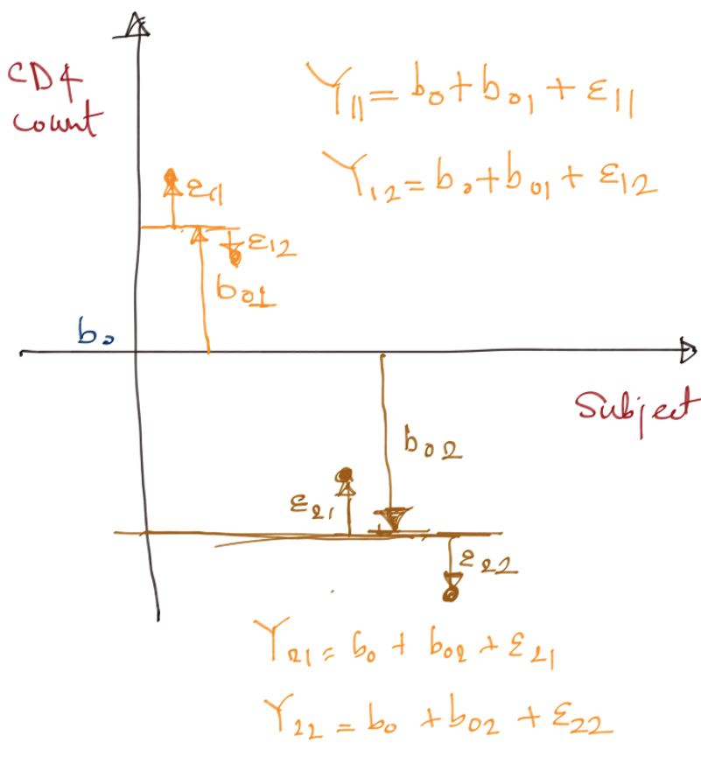
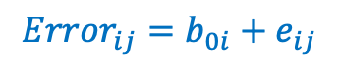
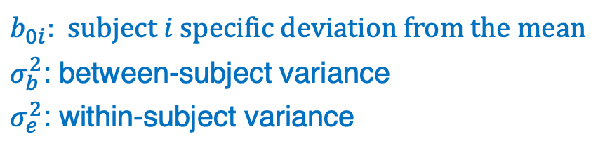
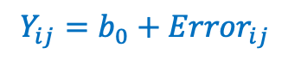
$$Y_{ij}=b_{0}+{Error}_{ij}$$
$${Error}_{ij}={b_{0i}+e}_{ij}$$
$b_{0i}$: subject $i$ specific deviation from the mean
$σ_{b}^{2}$: between-subject variance
$σ_{e}^{2}$: within-subject variance
How would a picture of the model look like?
Will we be able to see a correlation of CD4 between the two timepoints?
YES! Congrats! You have (probably) visualized your first Linear Mixed Effects Model!
Adapted from Alan Hubbard and Nicolas Jewell, UCB

Slide 21
True versus Naïve estimates of standard error of mean
True standard error of a mean estimate takes into account of the fact that observations made within a subject are correlated with each other
Naïve standard error of a mean estimate ignores this fact

Slide 22
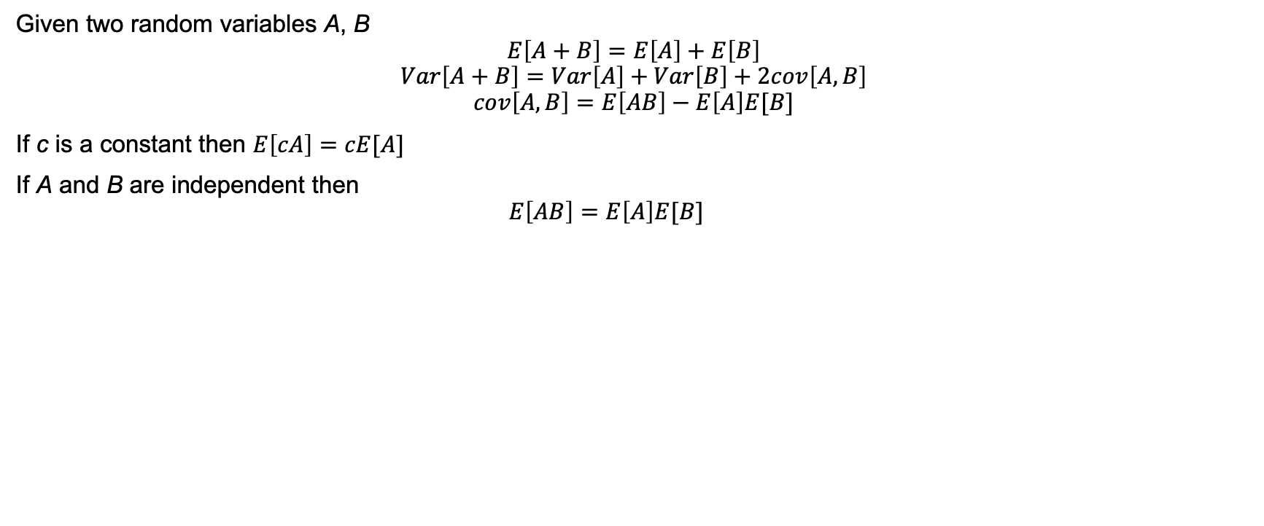
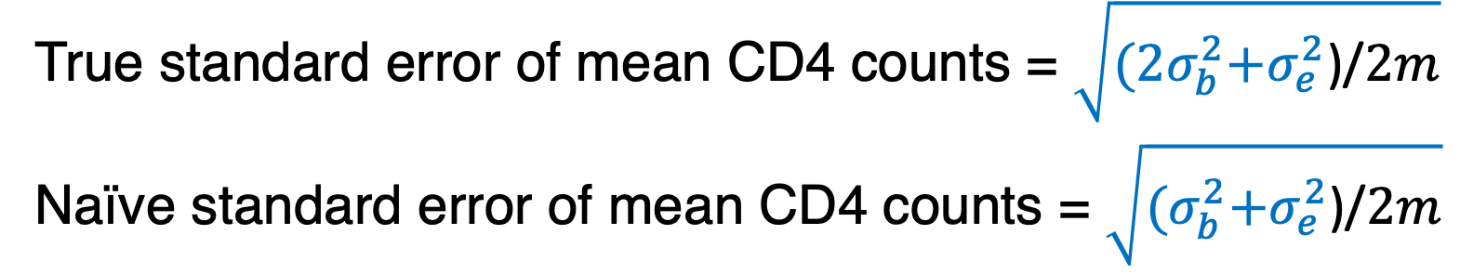
Useful formulae to help the mathematically minded derive the standard error formulae below
Given two random variables A, B
$$E\left[A+B\right]=E\left[A\right]+E\left[B\right]$$
$$Var\left[A+B\right]=Var\left[A\right]+Var\left[B\right]+2cov\left[A,B\right]$$
$$cov\left[A,B\right]=E\left[AB\right]−E\left[A\right]E[B]$$
If c is a constant then $E\left[cA\right]=cE[A]$
If A and B are independent then
$$E\left[AB\right]=E\left[A\right]E[B]$$
True standard error of mean CD4 counts = $\sqrt{{(2σ}_{b}^{2}+σ_{e}^{2}\text{)/}2m}$
Naïve standard error of mean CD4 counts = $\sqrt{{(σ}_{b}^{2}+σ_{e}^{2}\text{)/}2m}$

Slide 23
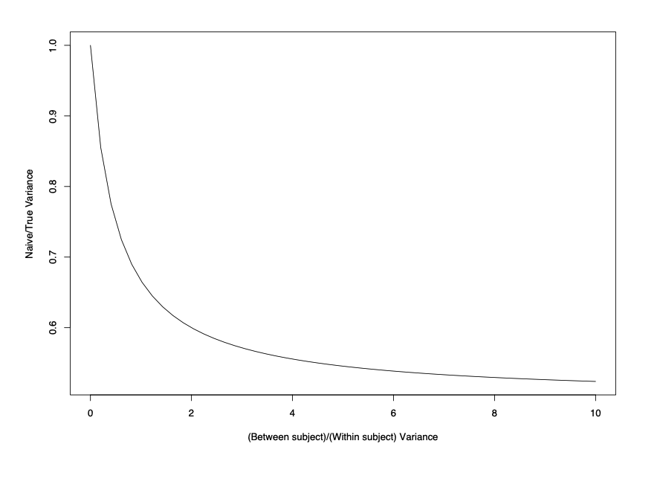
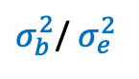
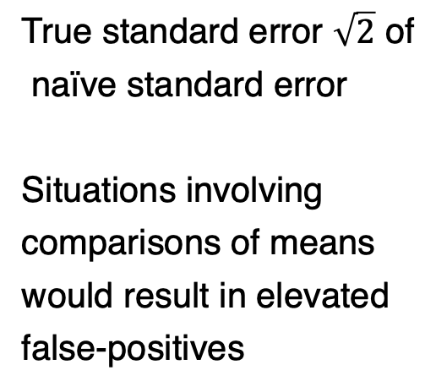
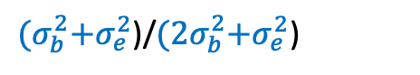
False-positives will blow up if you fail account for correlations between measurements within each subject
True standard error $\sqrt{2}$ of
naïve standard error
Situations involving
comparisons of means
would result in elevated
false-positives
${(σ}_{b}^{2}+σ_{e}^{2}$)/${(2σ}_{b}^{2}+σ_{e}^{2}$)
Adapted from Alan Hubbard and Nicolas Jewell, UCB
$σ_{b}^{2}$/ $σ_{e}^{2}$

Slide 24
Deficiencies of standard approaches
Increased false positives
Biased estimates in cases where you have time-varying predictors (e.g. see CD4 count example: cross-sec. vs longitudinal effect)
Unable to quantify variability due to different sources – inter-animal/inter-person variability, plate-to-plate variability

Slide 25
Approaches to statistically model repeated measures
Work with pseudo-bulk/consolidate the repeated measures
Repeated measures ANOVA
Linear Mixed Effects Models
Generalized Estimating Equations (GEE)

Slide 26
Pseudo-bulk/consolidate the repeated measures
Take mean of all repeated observations from a given biological replicate
CD4 count: Mean CD4 count for each subject across the two time-points
scRNA-seq: Mean counts of gene expression across all cells for a given biological sample
Proceed with “standard” analysis at the biological replicate level
Works in only simple experimental designs
Statistical analyses may not end up being powerful particularly if the responses are binary, count-based
Unable to quantify variability due to different sources – inter-animal/inter-person variability, plate-to-plate variability

Slide 27
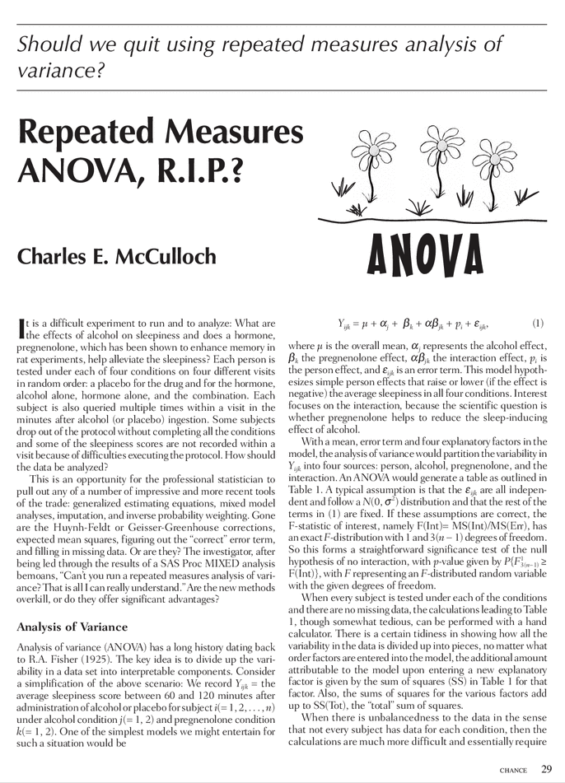
Repeated measures ANOVA, R.I.P.
Works only with discrete covariates
Require complete data, no missing data
Assumption of “sphericity”: all measurements from the same biological replicate are equally correlated with each other no matter how far apart in time they are
Never use!

Slide 28
Outline for this session
Repeated measures experimental designs are ubiquitous in our field
Several examples from our work
Specialized analyses of data from repeated measures are required to
Capture interesting biology
To not be overwhelmed with false positives
Linear mixed effects models provide a very flexible approach to work with these data
Introduction and assumptions for these models: WHAT?
These models can be implemented in the lme4 package in R
Illustrate implementations of these models using different datasets derived from varying experimental designs
Concluding remarks

Slide 29
Linear Mixed effects Models (LMM)
Linear mixed effects models are statistical models of data generated/observed under repeated measure scenarios
It does this through the use of fixed and random effects
Fixed effects
Capture population characteristics
Shared by all individuals in the population
Random effects
Subject-specific effects
Varies from subject to subject
Assumes it is drawn from a Normal Probability distribution
Adapted from Mariel Finucane

Slide 30
Advantages of LMM
Works with continuous and discrete covariates
Accommodates any level of imbalance or missing data
Accommodates data at all levels of the hierarchy involved in the experimental design
Doesn’t make the “sphericity” assumption
Adapted from Mariel Finucane

Slide 31
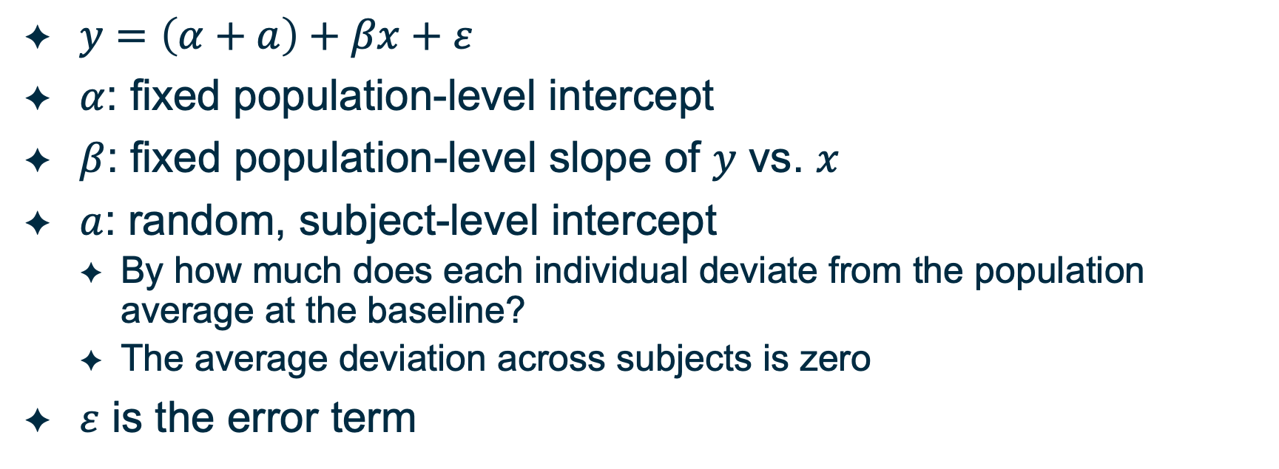
LMM: Simple Random Intercept Model
$y=\left(α+a\right)+βx+ε$
$α$: fixed population-level intercept
$β$: fixed population-level slope of $y$ vs. $x$
$a$: random, subject-level intercept
By how much does each individual deviate from the population average at the baseline?
The average deviation across subjects is zero
$ε$ is the error term
Adapted from Mariel Finucane

Slide 32
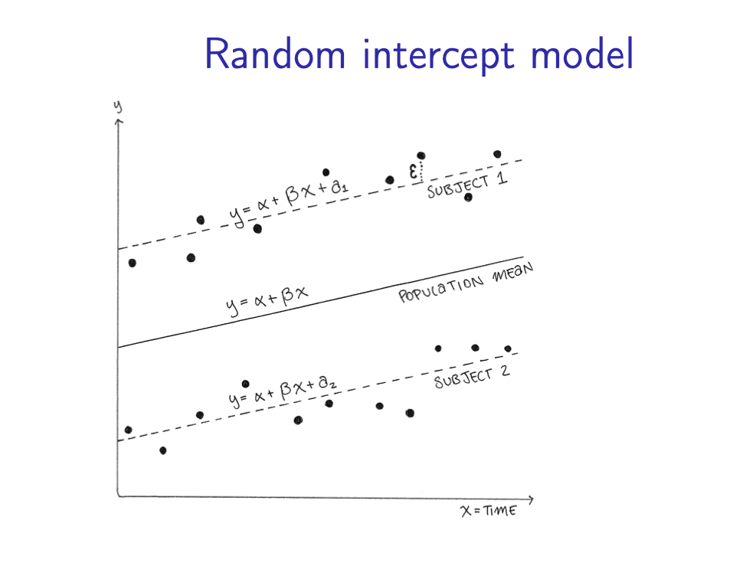


LMM: Simple Random Intercept Model
CD4 cell count
Time
Adapted from Mariel Finucane
Notes:
https://cdn1.vectorstock.com/i/1000x1000/75/30/cartoon-male-standing-human-resources-design-icon-vector-10787530.jpg
https://iheartcraftythings.com/wp-content/uploads/2021/05/Cartoon-People-DRAWING-–-STEP-10.jpg
https://img.freepik.com/premium-vector/woman-cartoon-icon-avatar-people-person-human-theme-isolated-design-vector-illustration_25030-10955.jpg
https://previews.123rf.com/images/grgroup/grgroup2001/grgroup200104361/139105896-woman-cartoon-drawing-design-girl-female-person-people-human-and-social-media-theme-vector-illustrat.jpg

Slide 33


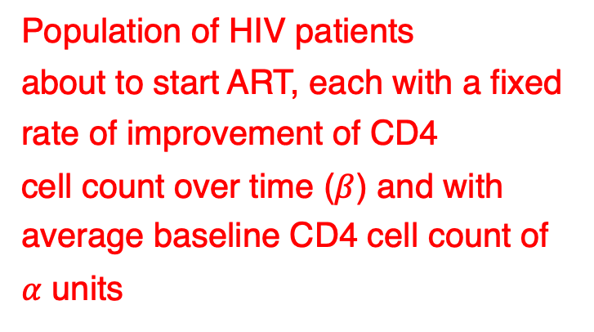
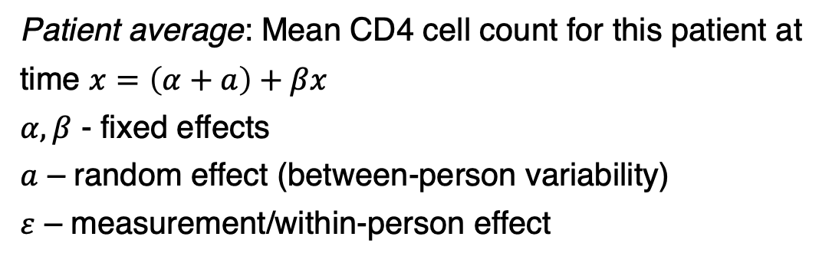
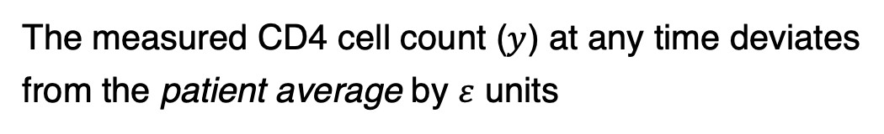
LMM: Simple Random Intercept Model
Population of HIV patients
about to start ART, each with a fixed
rate of improvement of CD4
cell count over time ($β$) and with
average baseline CD4 cell count of
$α$ units
sample a patient from this population
Repeat over multiple patients
This patient’s baseline CD4 cell count deviates
from the population average by a units
Patient average: Mean CD4 cell count for this patient at
time $x=\left(α+a\right)+βx$
$α,β$ - fixed effects
$a$ – random effect (between-person variability)
$ε$ – measurement/within-person effect
Monitor this patient’s CD4 cell count over time
The measured CD4 cell count ($y$) at any time deviates
from the patient average by $ε$ units
Notes:
https://cdn1.vectorstock.com/i/1000x1000/75/30/cartoon-male-standing-human-resources-design-icon-vector-10787530.jpg
https://iheartcraftythings.com/wp-content/uploads/2021/05/Cartoon-People-DRAWING-–-STEP-10.jpg
https://img.freepik.com/premium-vector/woman-cartoon-icon-avatar-people-person-human-theme-isolated-design-vector-illustration_25030-10955.jpg
https://previews.123rf.com/images/grgroup/grgroup2001/grgroup200104361/139105896-woman-cartoon-drawing-design-girl-female-person-people-human-and-social-media-theme-vector-illustrat.jpg

Slide 34
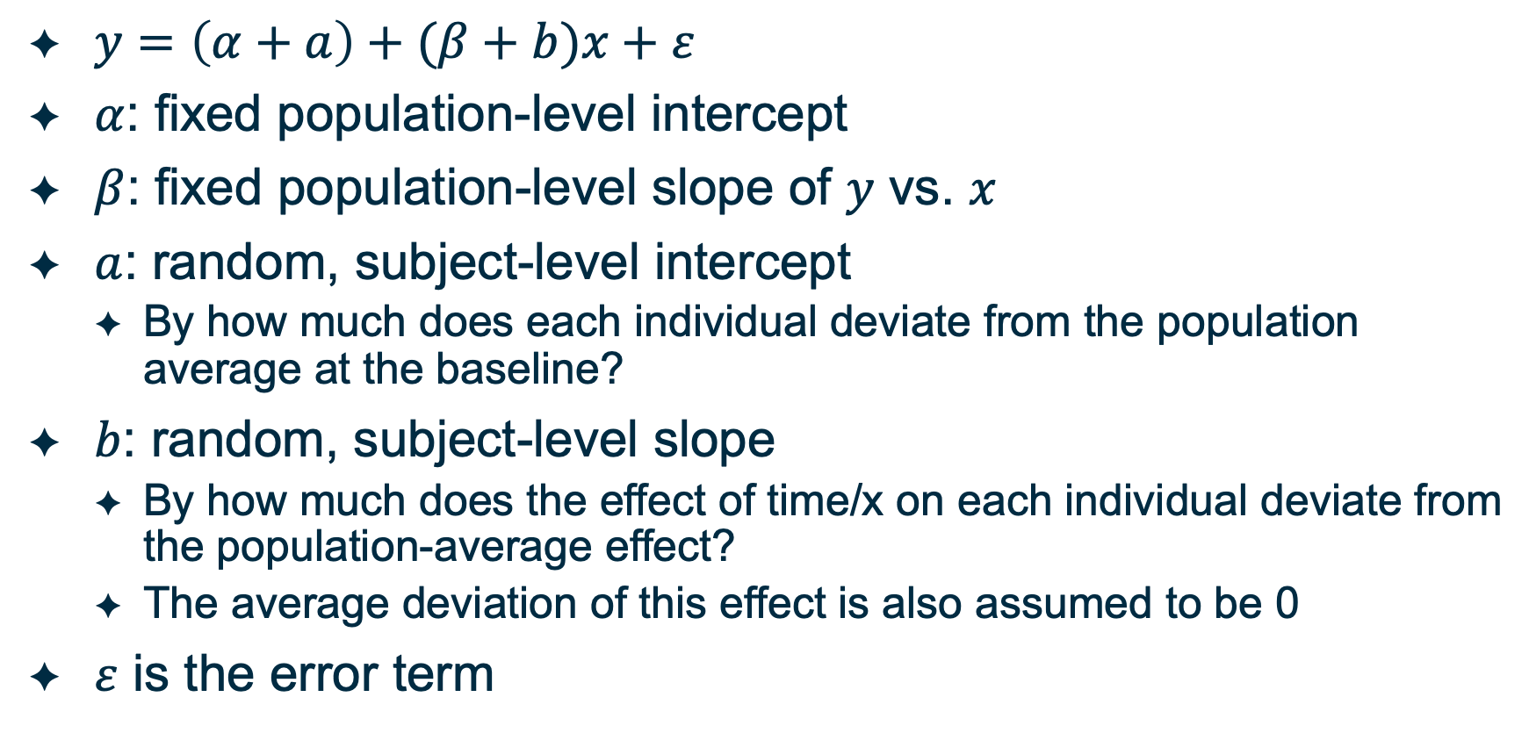
LMM: Random slope, Random intercept Model
$y=\left(α+a\right)+(β+b)x+ε$
$α$: fixed population-level intercept
$β$: fixed population-level slope of $y$ vs. $x$
$a$: random, subject-level intercept
By how much does each individual deviate from the population average at the baseline?
$b$: random, subject-level slope
By how much does the effect of time/x on each individual deviate from the population-average effect?
The average deviation of this effect is also assumed to be 0
$ε$ is the error term
Adapted from Mariel Finucane

Slide 35
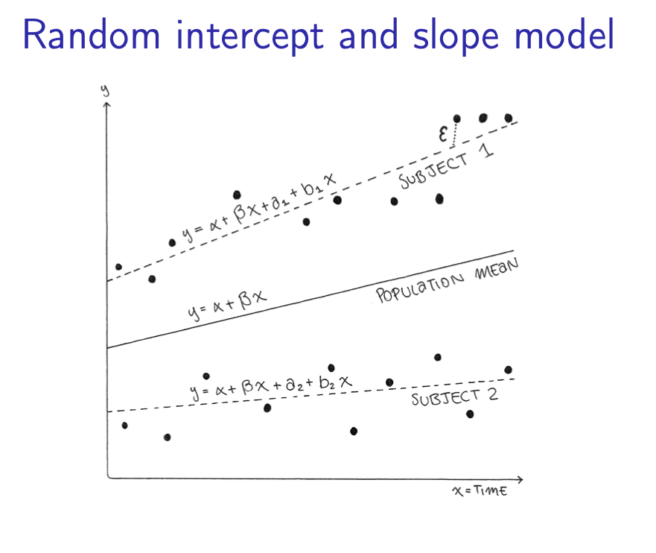
LMM: Random slope, Random intercept Model
Adapted from Mariel Finucane

Slide 36
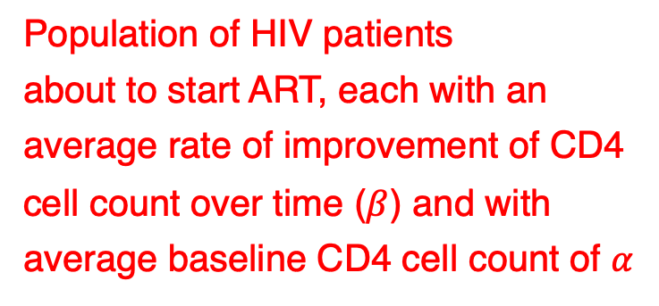
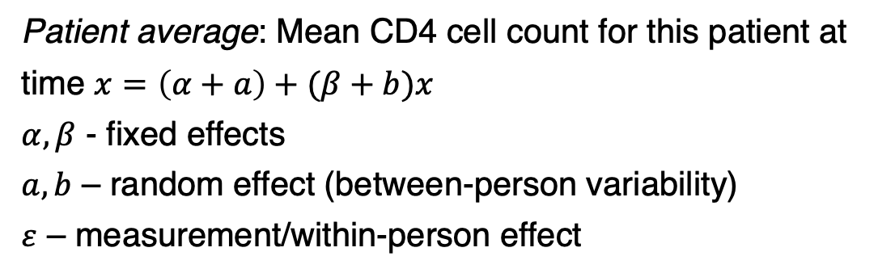
LMM: Random slope, Random Intercept Model
Population of HIV patients
about to start ART, each with an
average rate of improvement of CD4
cell count over time ($β$) and with
average baseline CD4 cell count of $α$
sample a patient from this population
Repeat over multiple patients
This patient’s baseline CD4 cell count deviates
from the population average by a units and
whose improvement over time deviates by
b units
Patient average: Mean CD4 cell count for this patient at
time $x=\left(α+a\right)+(β+b)x$
$α,β$ - fixed effects
$a,b$ – random effect (between-person variability)
$ε$ – measurement/within-person effect
Monitor this patient’s CD4 cell count over time
The measured CD4 cell count ($y$) at any time deviates
from the patient average by $ε$ units
Notes:
https://cdn1.vectorstock.com/i/1000x1000/75/30/cartoon-male-standing-human-resources-design-icon-vector-10787530.jpg
https://iheartcraftythings.com/wp-content/uploads/2021/05/Cartoon-People-DRAWING-–-STEP-10.jpg
https://img.freepik.com/premium-vector/woman-cartoon-icon-avatar-people-person-human-theme-isolated-design-vector-illustration_25030-10955.jpg
https://previews.123rf.com/images/grgroup/grgroup2001/grgroup200104361/139105896-woman-cartoon-drawing-design-girl-female-person-people-human-and-social-media-theme-vector-illustrat.jpg

Slide 37
Outline for this session
Repeated measures experimental designs are ubiquitous in our field
Several examples from our work
Specialized analyses of data from repeated measures are required to
Capture interesting biology
To not be overwhelmed with false positives
Linear mixed effects models provide a very flexible approach to work with these data
Introduction and assumptions for these models
These models can be implemented in the lme4 package in R
Illustrate implementations of these models using different datasets derived from varying experimental designs
Concluding remarks

Slide 38
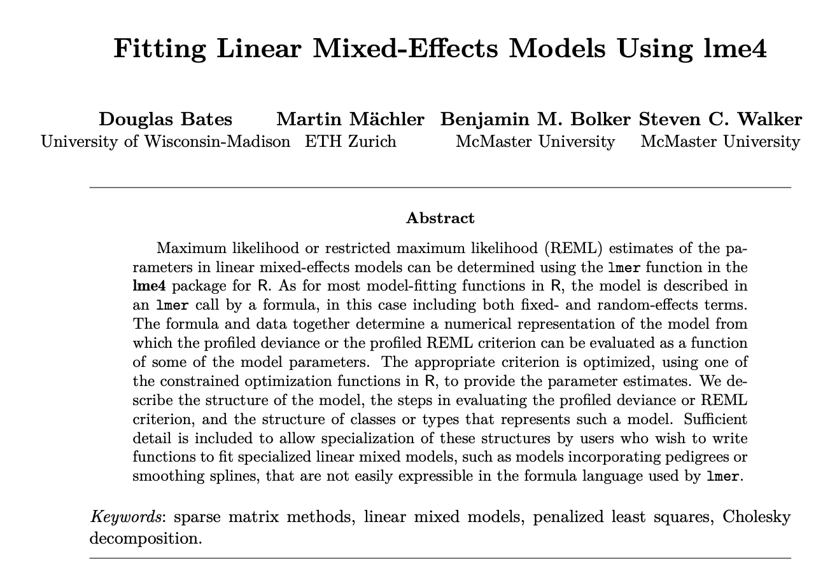
lme4 R package is a well-accepted standard implementation of LMM

Slide 39
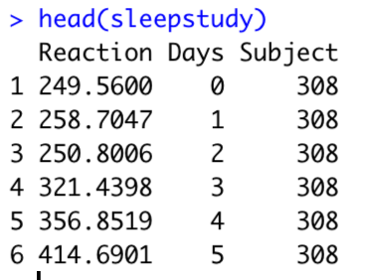
sleepstudy: How does reaction time change with the amount of sleep deprivation?

Slide 40
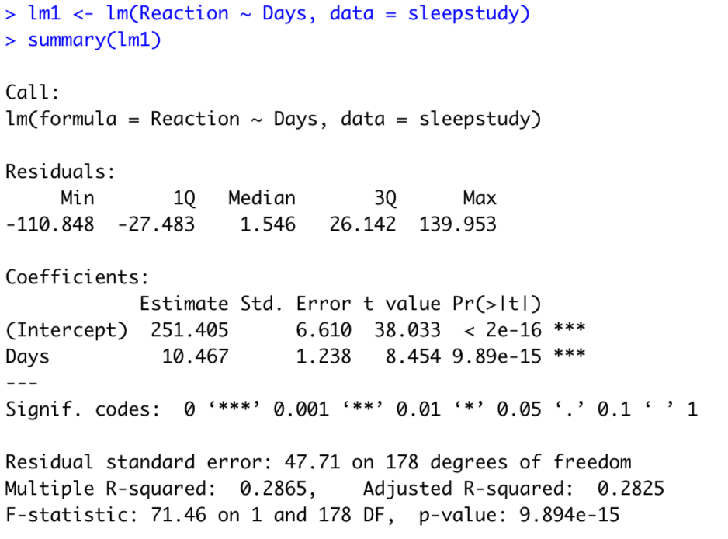
sleepstudy: Increase in reaction time with increase in sleep deprivation- Linear Model implementation

Slide 41
sleepstudy: Baseline reaction times and change with sleep deprivation changes from subject-to-subject

Slide 42
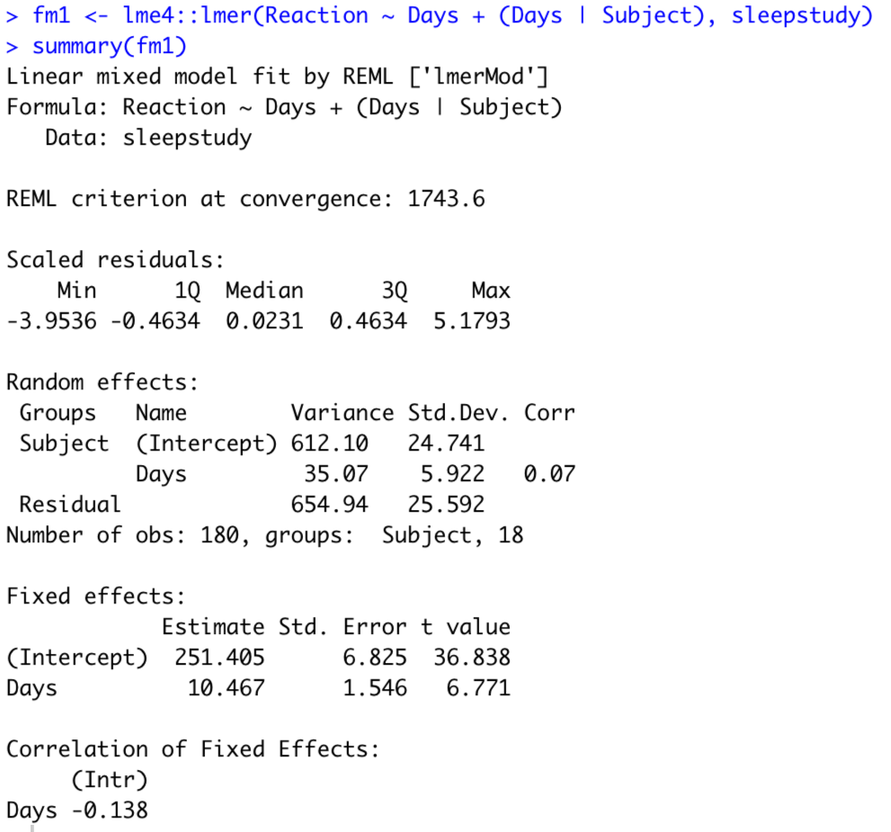
sleepstudy: LMM vs. LM implementation to assess impact of sleep deprivation
LMM implementation
Random slope and intercept model
LM implementation
Fixed effects are the same!

Slide 43
sleepstudy: LMM vs. LM implementation
LMM implementation
LM implementation
Standard errors are different!

Slide 44
sleepstudy: LMM vs. LM implementation
LMM implementation
Between-subject variance of baseline reaction times
Between-subject variance of change of reaction times with time
Within-subject/measurement error variance

Slide 45
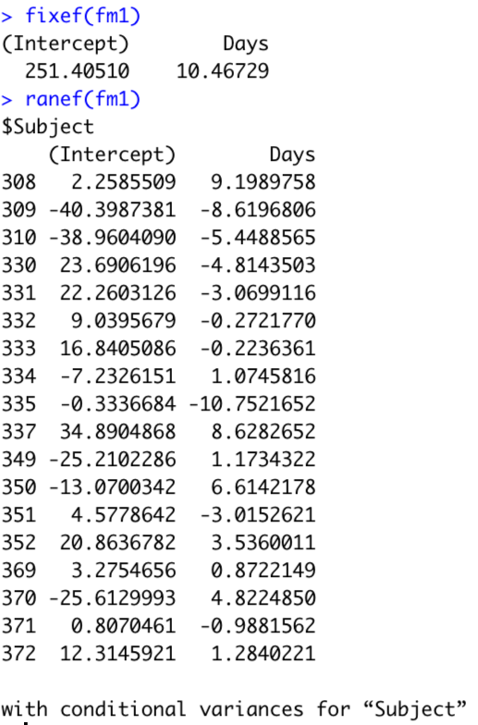
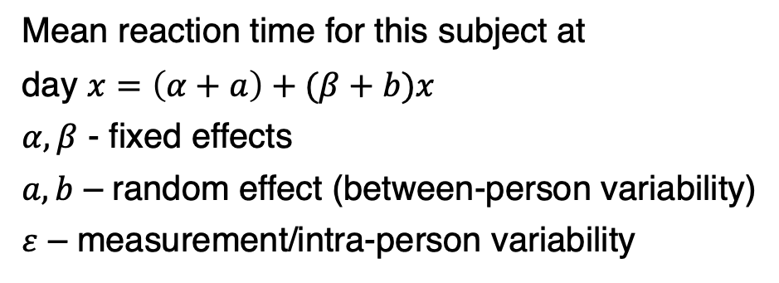
sleepstudy: LMM vs. LM implementation
Fixed effects
LMM implementation
Random effects
Mean reaction time for this subject at
day $x=\left(α+a\right)+(β+b)x$
$α,β$ - fixed effects
$a,b$ – random effect (between-person variability)
$ε$ – measurement/intra-person variability

Slide 46
sleepstudy data: conclusions
Experimental design involves longitudinal data collected for multiple subjects
The LMM correctly treats individual subjects in the study as replicates or independent units
The linear model incorrectly treats individual observations as independent units
The linear model pretends that there is more information than is really presents
Consequently, it under-predicts the standard error

Slide 47
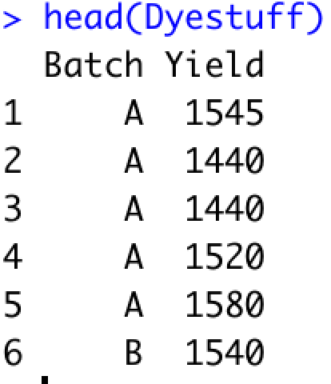
Dyestuff: Does the Batch of an intermediate product affect the Yield of dye?

Slide 48
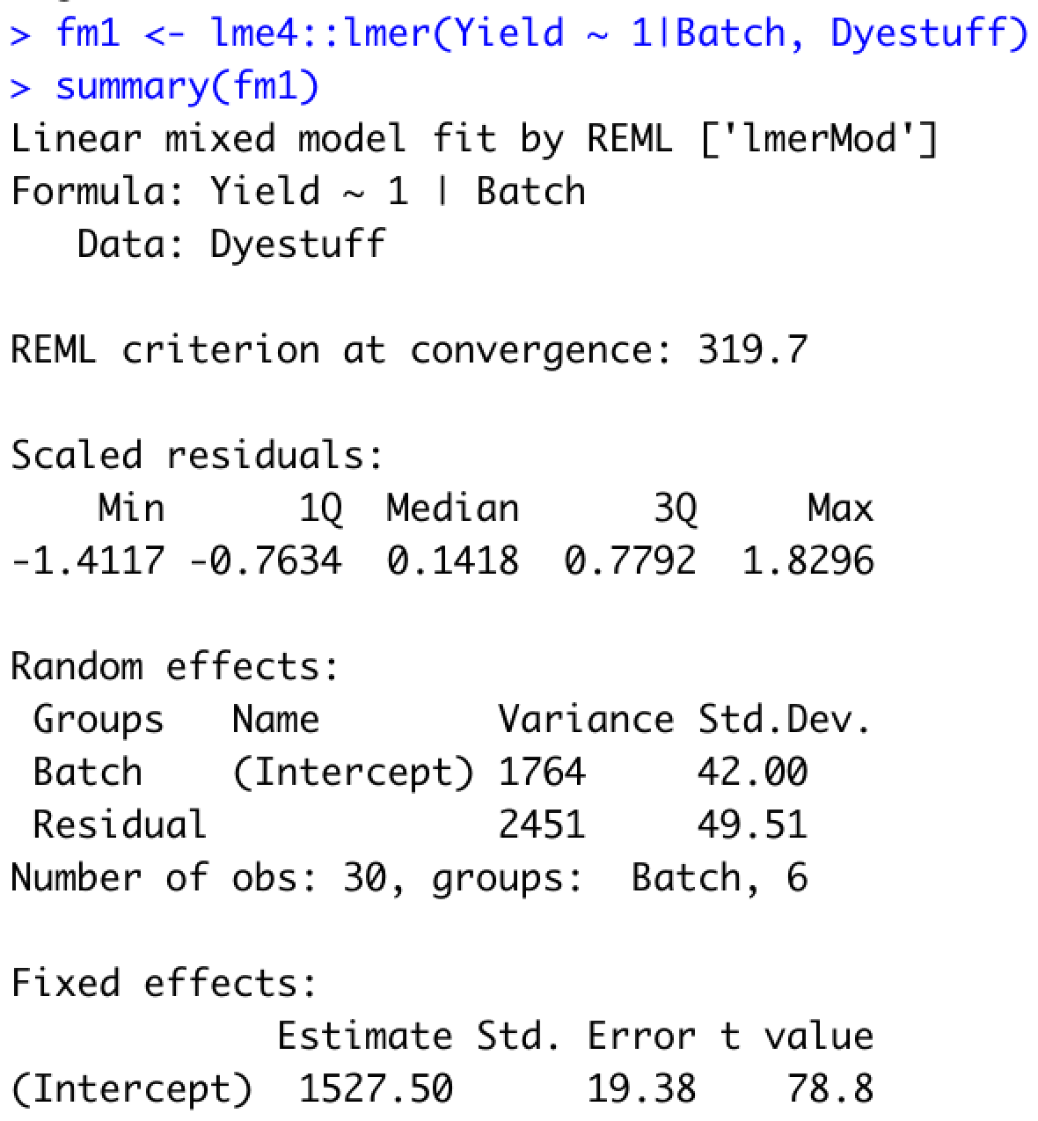
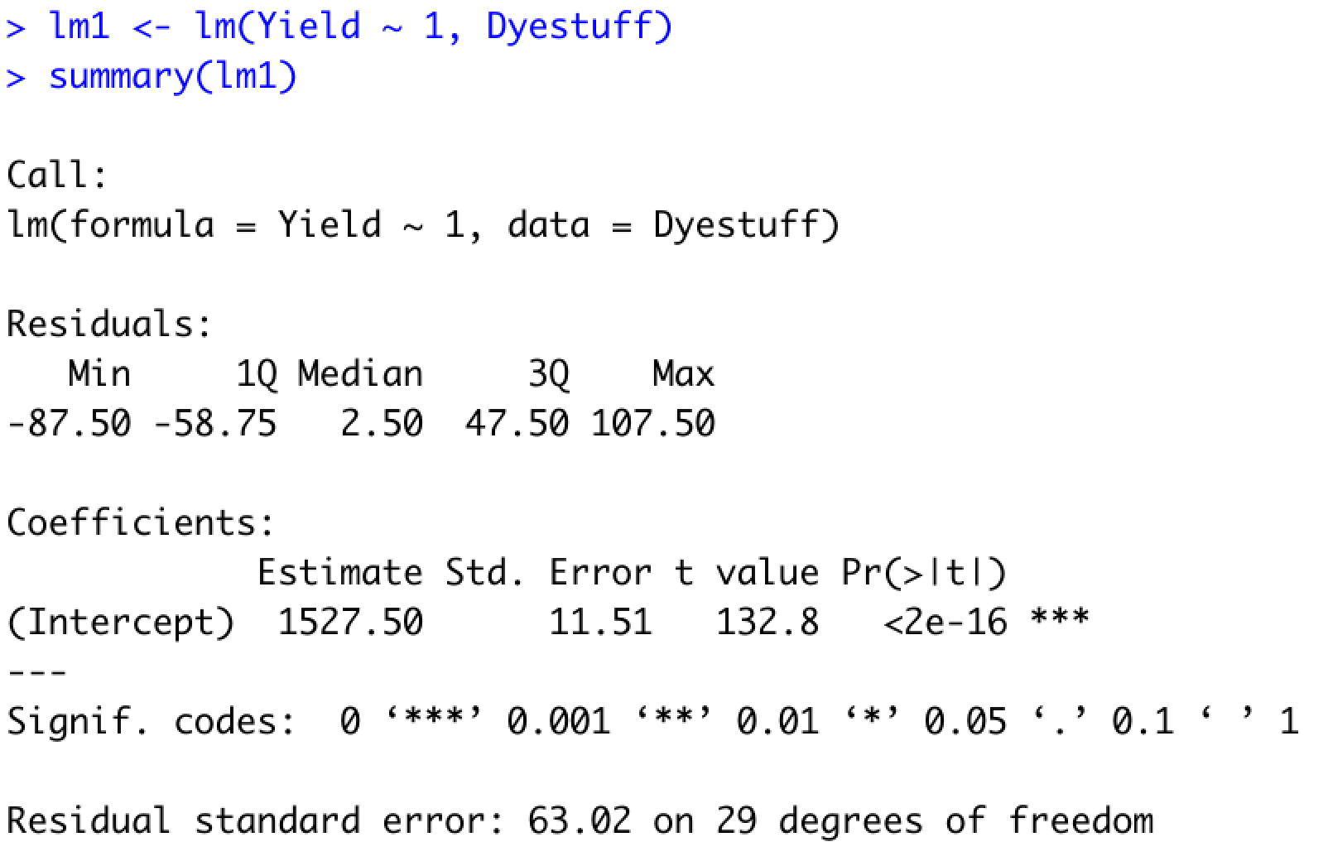
Dyestuff: LMM vs LM implementation to estimate mean Yield
Standard errors are different, like before!

Slide 49
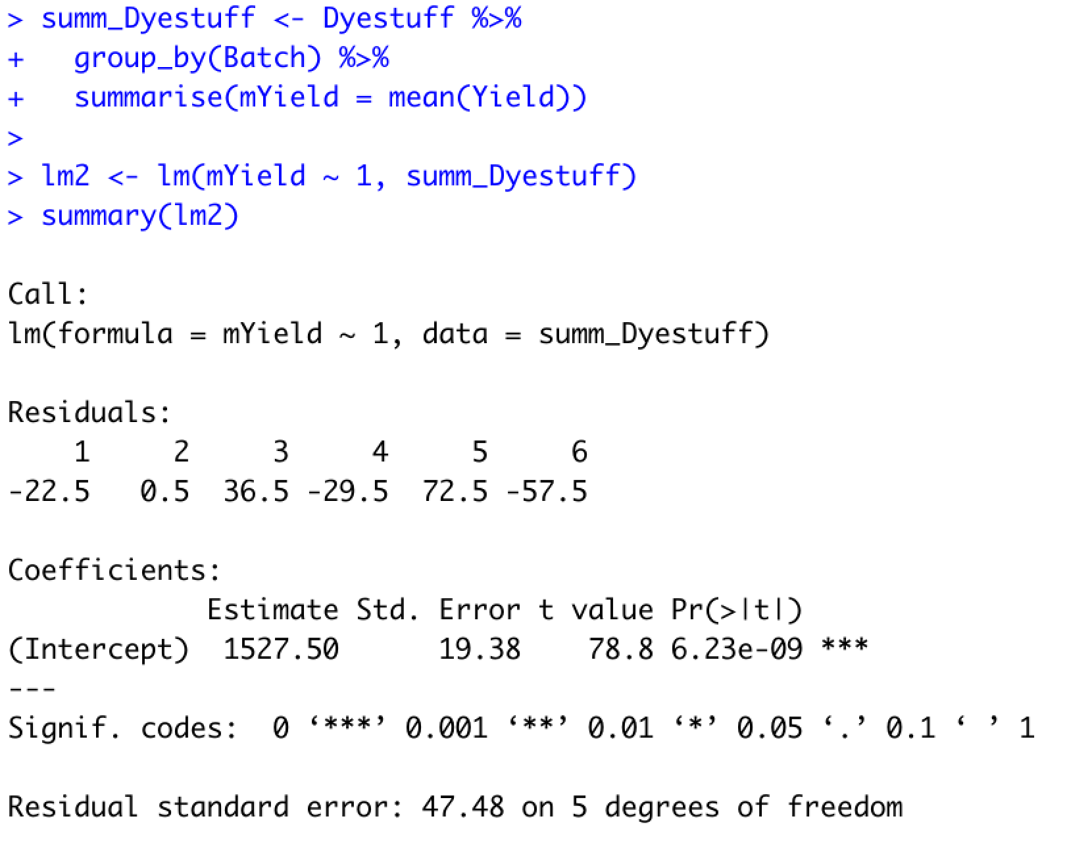
Dyestuff: Instead of LMM, we can “pseudo-bulk” the Yield within each batch
Pseudo-bulk Yield
Pseudo-bulking resulted in the correct standard errors!

Slide 50
Dyestuff data: conclusions
Experimental design involving a simple random effect
The simpler strategy of pseudo-bulking the response results in the same standard error estimates as the more complex LMM

Slide 51
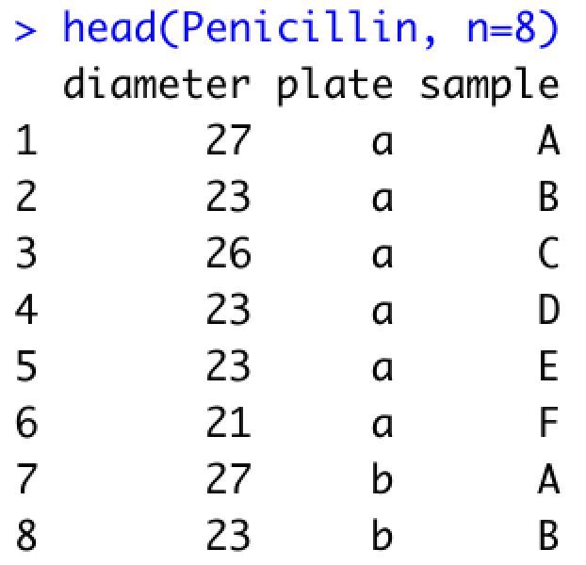
Penicillin: Variation in Penicillin testing
Six samples of penicillin were tested using the B. subtilis plate method on each of 24 plates. The response is the diameter (mm) of the zone of inhibition of growth of the organism.

Slide 52
Penicillin: We would like to estimate the mean diameter
What should be regard as replicates?
Individual observations?
Individual plates?
Individual samples?

Slide 53
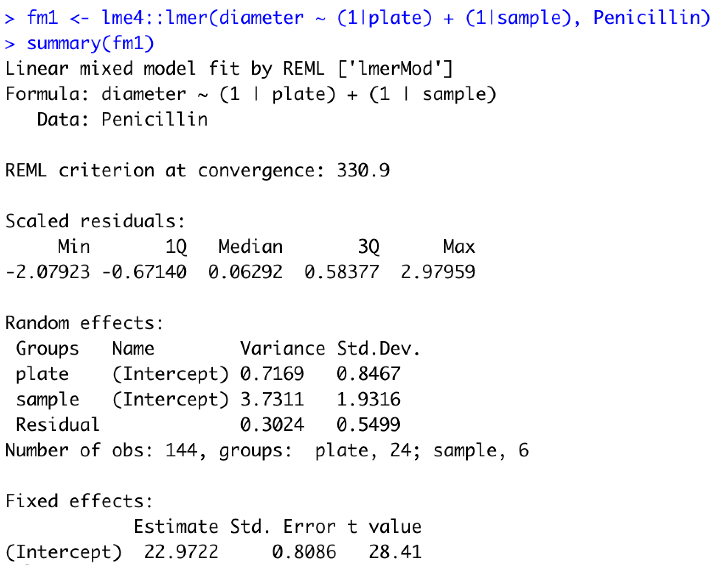
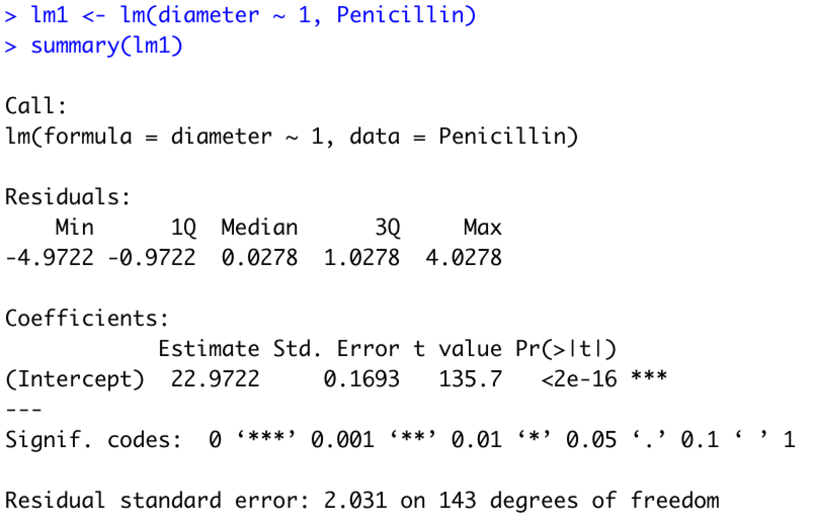
Penicillin: LMM vs LM implementation to estimate mean diameter
Two crossed random effects
Mean estimate exactly same, whereas standard errors differ!

Slide 54
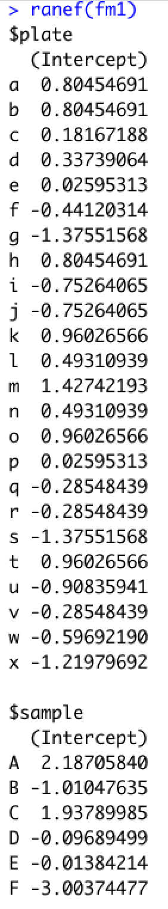
Random effect/intercept estimates from Penicillin data

Slide 55
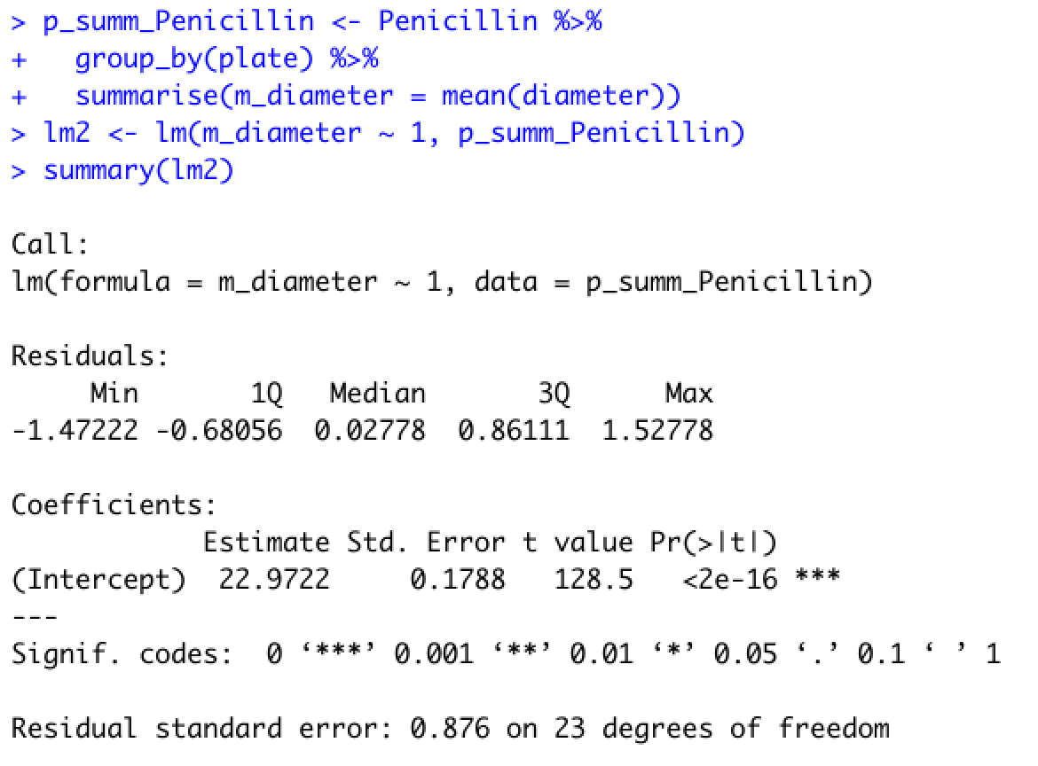
How about we pseudo-bulk by plate?
Two random effects
Pseudo-bulk diameter
Standard errors are different!

Slide 56
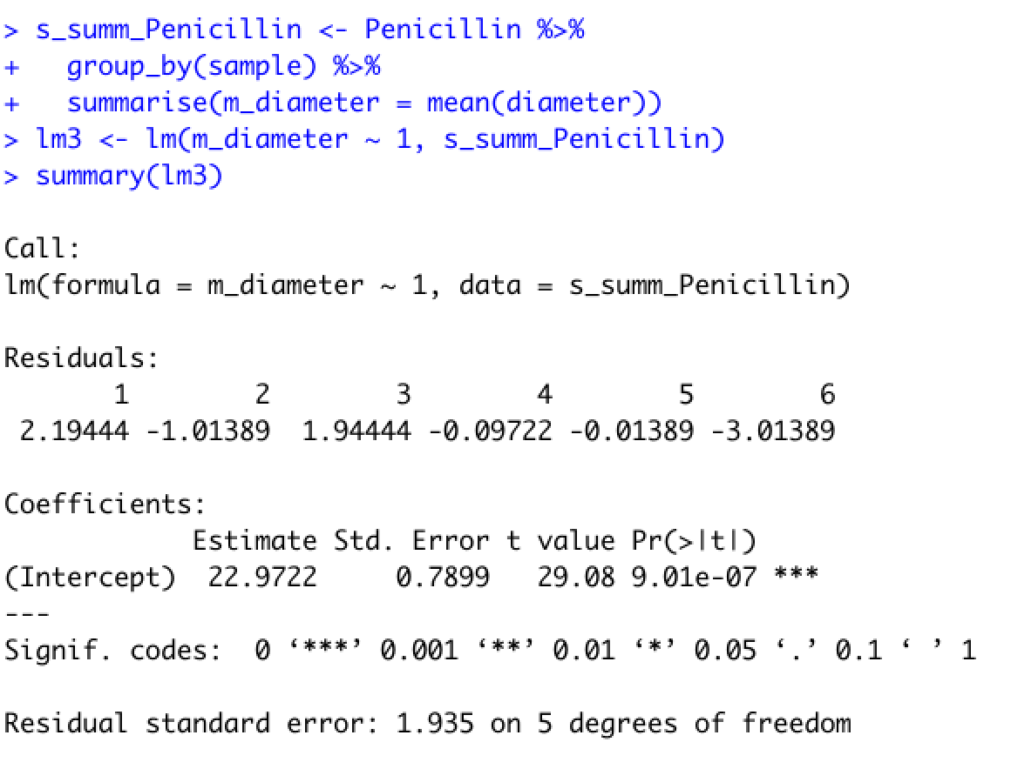
How about we pseudo-bulk by sample?
Two crossed random effects
Pseudo-bulk diameter
Standard errors are still different!

Slide 57
Penicillin data: conclusions
Experimental design involves two crossed random effects
Pseudo-bulking by one of these random effects does not result in the correct estimates of the standard errors
LMM does not necessitate explicitly defining what the replicates represent while taking into account the correlation in the responses induced by plate and sample

Slide 58
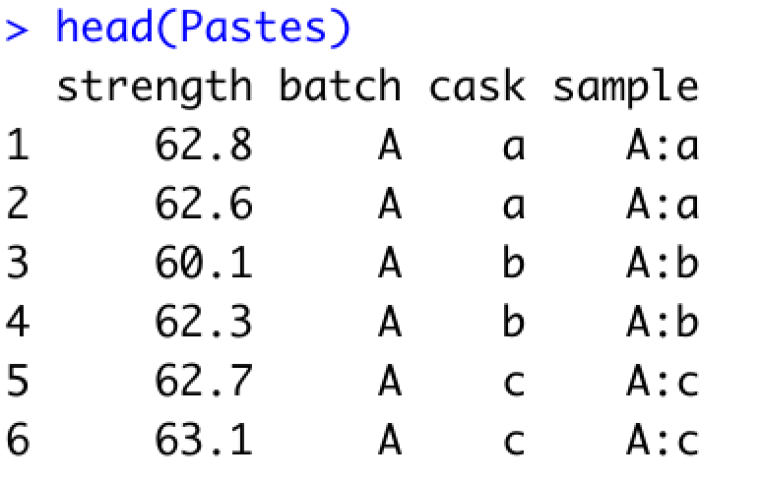
Pastes data
Strength of a chemical paste product; its quality depending on the delivery batch, and the cask within the delivery batch.

Slide 59
Pastes: We would like to estimate the mean strength
What should be regard as replicates?
Individual observations?
Individual batches?
Individual casks?
Casks are not independent of batches
Similarly, in cellular assays responses measured in wells are dependent on the plates from which they were measured

Slide 60
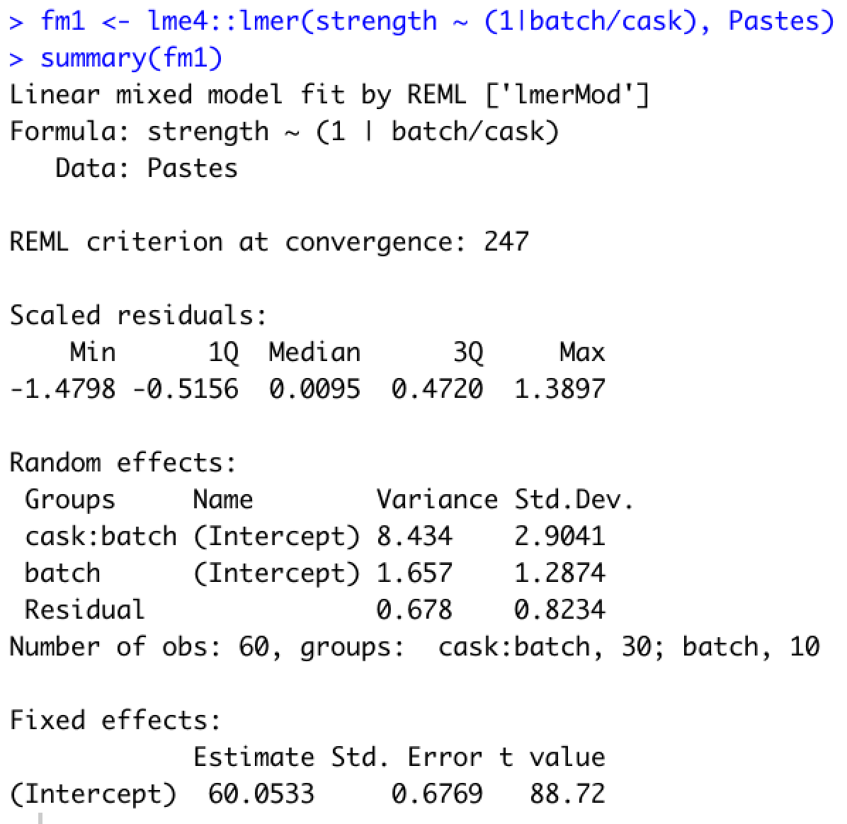
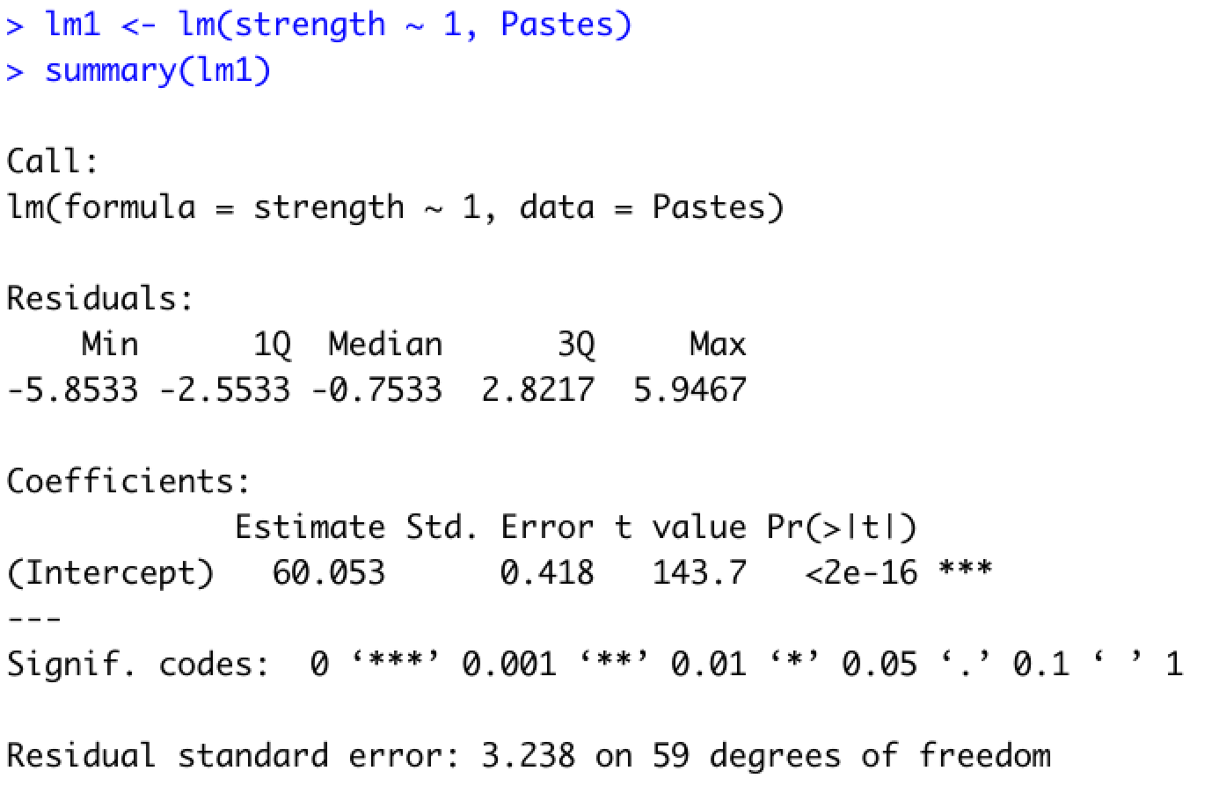
Pastes: LMM vs LM implementation to estimate mean strength
LMM implementation
LM implementation
Two nested random effects
Standard errors are different!

Slide 61

Pastes: Correct vs Incorrect LMM implementation to estimate mean strength
Correct implementation
Incorrect implementation
Two nested random effects
Nested random effects treated as crossed
Standard errors and Variance estimates are different!

Slide 62
Pastes data: conclusions
Hierarchical experimental design involves two nested random effects
LMM does not necessitate explicitly defining what the replicates represent while taking into account the correlation in the responses induced by batch and casks within a batch
Need to correctly specify the hierarchical nature of the design in the LMM specification

Slide 63

Specification of random and fixed effects
Dyestuff
Pastes
Penicillin
sleepstudy

Slide 64
Additional considerations
LMM comes with the same assumptions as linear models
In addition, it makes distributional assumptions about the random effects, i.e., assumption of normality for not only the residuals but also for each of the random effects
Residual and q-q plots are useful diagnostics to verify assumptions
Generalized Linear Mixed Models (GLMM) work with a wider range of response characteristics including binary (0-1), count based ones

Slide 65
Outline for this session
Repeated measures experimental designs are ubiquitous in our field
Several examples from our work: WHERE?
Specialized analyses of data from repeated measures are required to
Capture interesting biology: WHY?
To not be overwhelmed with false positives
Linear mixed effects models provide a very flexible approach to work with these data
Introduction and assumptions for these models: WHAT?
These models can be implemented in the lme4 package in R
Illustrate implementations of these models using different datasets derived from varying experimental designs: HOW?
Concluding remarks

Slide 66
Conclusions
Linear mixed effect models are used to model data collected under repeated measures scenarios
It requires you to clearly be able to identify the key variables involved in generating your data
It is very flexible in modeling diverse experimental designs
Correct modeling results in right control of false-positives
It implicitly deals with the need to identify the independent replicates while remaining true to the underlying experimental design for the data
Get estimates of variability due to different sources
Useful for designing your experiments with repeated measures

Slide 67
It is a bit of learning curve, so…
..please contact/consult/collaborate with us,
particularly, in situations where you are dealing with repeated measures data and are unsure on how to construct a model to derive estimates of interest.
We are a Core with the primary function of providing statistical and bioinformatic support
Email: bioinformatics@gladstone.ucsf.edu
Website: https://gladstone.org/science/bioinformatics-core
Slack channel: https://gladstoneinstitutes.slack.com/archives/C0145F1L7QS

Slide 68
Your feedback is important to us!
https://www.surveymonkey.com/r/F75J6VZ
~3 min.

Slide 70
sleepstudy: Baseline reaction times and change with sleep deprivation changes from subject-to-subject

